Slide 1
Chapter 12
Pointers, Classes, Virtual Functions, Abstract Classes, and Lists

Slide 2
Objectives (1 of 3)
In this chapter, you will:
Learn about the pointer data type and pointer variables
Explore how to declare and manipulate pointer variables
Learn about the address of the operator and the dereferencing operator
Learn how pointers work with classes and structs
Discover dynamic variables

Slide 3
Objectives (2 of 3)
Explore how to use the new and delete operators to manipulate dynamic variables
Learn about pointer arithmetic
Learn how to work with dynamic arrays
Become familiar with the limitations of range-based for loops with dynamic arrays
Explore how pointers work with functions as parameters and functions as return values

Slide 4
Objectives (3 of 3)
Become familiar with the shallow and deep copies of data
Discover the peculiarities of classes with pointer member variables
Learn about virtual functions
Become aware of abstract classes
Learn about array based lists and the basic operations on them
Examine the relationship between the address of operator and classes

Slide 5
Pointer Data Type and Pointer Variables
A pointer variable is a variable whose content is a memory address
No name is associated with the pointer data type in C++

Slide 6

Declaring Pointer Variables (1 of 2)
The general syntax to declare a pointer variable is:
The statements below each declare a pointer:
int *p;
char *ch;
These statements are equivalent:
int *p;
int* p;
int * p;

Slide 7
Declaring Pointer Variables (2 of 2)
In the statement:
int* p, q;
Only p is a pointer variable
q is an int variable
To avoid confusion, attach the character * to the variable name:
int *p, q;
int *p, *q;

Slide 8
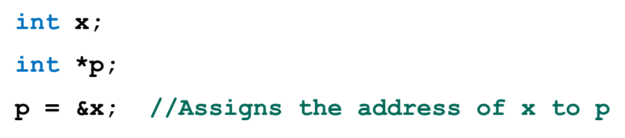
Address of Operator (&)
Address of operator (&):
A unary operator that returns the address of its operand
Example:

Slide 9

Dereferencing Operator (*)
Dereferencing operator (or indirection operator):
When used as a unary operator, * refers to object to which its operand points
Example:
Prints the value stored in the memory location pointed to by p

Slide 10
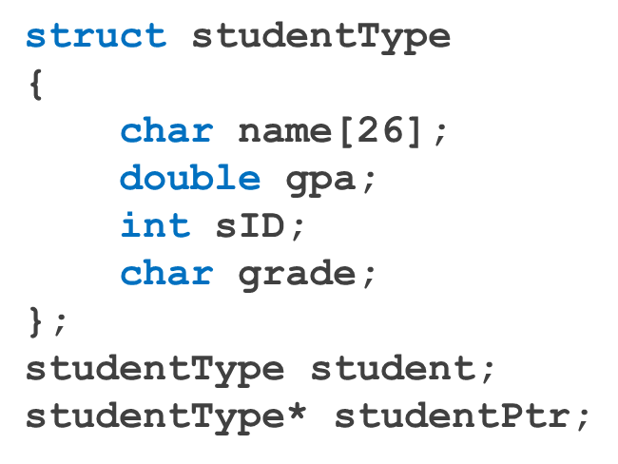
Classes, structs, and Pointer Variables (1 of 3)
You can declare pointers to other data types, such as a struct:
student is an object of type studentType
studentPtr is a pointer variable of type studentType

Slide 11


Classes, structs, and Pointer Variables (2 of 3)
To store address of student in studentPtr:
studentPtr = &student;
To store 3.9 in component gpa of student:
( ) used because dot operator has higher precedence than dereferencing operator
Alternative: use member access operator arrow

Slide 12

Classes, structs, and Pointer Variables (3 of 3)
Syntax to access a class (struct) member using the operator -> :
Thus,
(*studentPtr).gpa = 3.9;
is equivalent to:
studentPtr->gpa = 3.9;

Slide 13
Initializing Pointer Variables
C++ does not automatically initialize variables
Pointer variables must be initialized if you do not want them to point to anything
Initialized to the value 0 using the null pointer
Or, use the NULL named constant
The number 0 is the only number that can be directly assigned to a pointer variable
C++11 Standard includes a nullptr

Slide 14
Dynamic Variables
Dynamic variables are created during execution
C++ creates dynamic variables using pointers
new and delete operators: used to create and destroy dynamic variables
new and delete are reserved words in C++

Slide 15
Operator new (1 of 2)
new has two forms:
intExp is any expression evaluating to a positive integer
new allocates memory (a variable) of the designated type and returns a pointer to it
The allocated memory is uninitialized

Slide 16
Operator new (2 of 2)
Example: p = new int;
Creates a variable during program execution somewhere in memory
Stores the address of the allocated memory in p
To access allocated memory, use *p
A dynamic variable cannot be accessed directly
Because it is unnamed

Slide 17
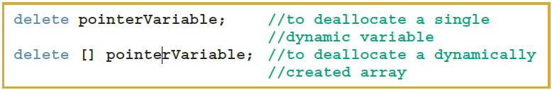
Operator delete
Memory leak: previously allocated memory that cannot be reallocated
To avoid a memory leak, when a dynamic variable is no longer needed, destroy it to deallocate its memory
delete operator: used to destroy dynamic variables
Syntax:

Slide 18
Operations on Pointer Variables (1 of 2)
Assignment: value of one pointer variable can be assigned to another pointer of same type
Relational operations: two pointer variables of same type can be compared for equality, etc.
Some limited arithmetic operations
Integer values can be added and subtracted from a pointer variable
Value of one pointer variable can be subtracted from another pointer variable

Slide 19
Operations on Pointer Variables (2 of 2)
Pointer arithmetic can be very dangerous:
Program can accidentally access memory locations of other variables and change their content without warning
Some systems might terminate the program with an appropriate error message
Always exercise extra care when doing pointer arithmetic

Slide 20
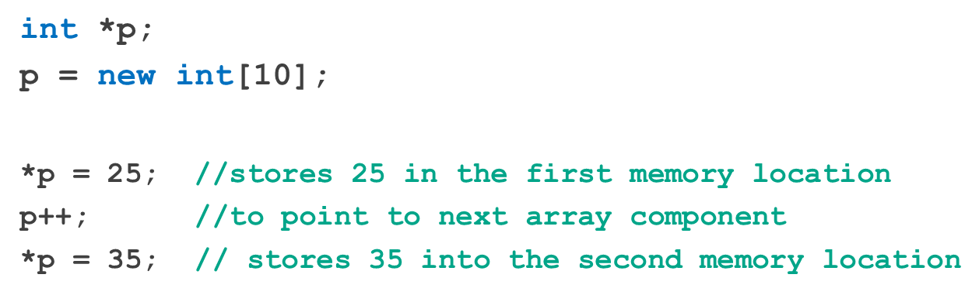
Dynamic Arrays (1 of 2)
Dynamic array: array created during program execution
Example:

Slide 21
Dynamic Arrays (2 of 2)
Can use array notation to access these memory locations
Example:
p[0] = 25;
p[1] = 35;
Stores 25 and 35 into the first and second array components, respectively
An array name is a constant pointer

Slide 22
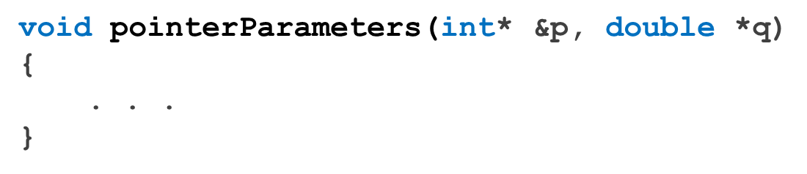
Functions and Pointers
Pointer variable can be passed as a parameter either by value or by reference
As a reference parameter in a function heading, use &:

Slide 23
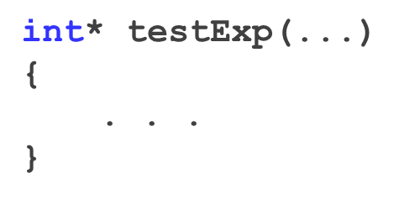
Pointers and Function Return Values
A function can return a value of type pointer:

Slide 24
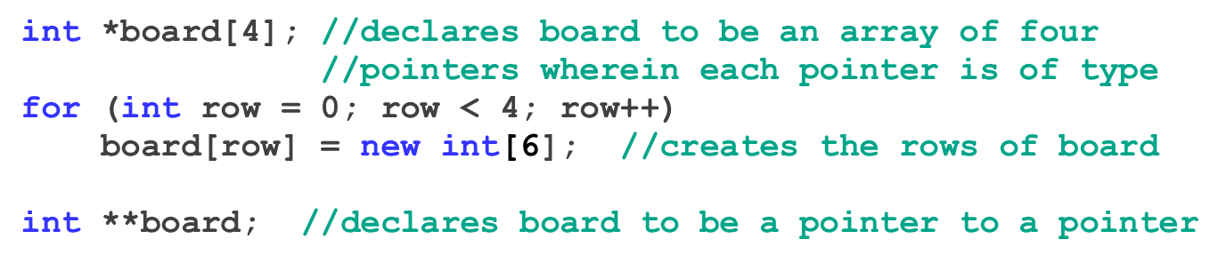
Dynamic Two-Dimensional Arrays
You can create dynamic multidimensional arrays
Examples:

Slide 25
Shallow versus Deep Copy and Pointers
Shallow copy: when two or more pointers of the same types point to the same memory
They point to the same data
Danger: deleting one deletes the data pointed to by all of them
Deep copy: when the contents of the memory pointed to by a pointer are copied to the memory location of another pointer
Two copies of the data

Slide 26
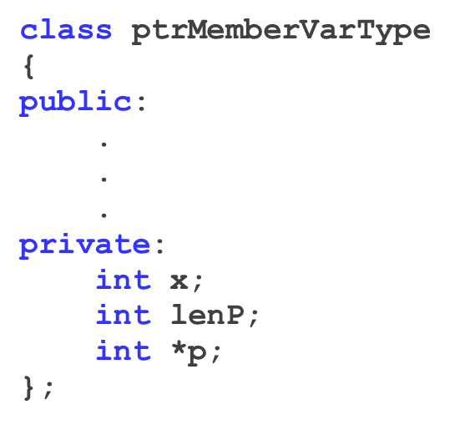
Classes and Pointers: Some Peculiarities (1 of 2)
Example class:
Example program statements:
ptrMemberVarType objectOne;
ptrMemberVarType objectTwo;

Slide 27

Classes and Pointers: Some Peculiarities (2 of 2)
FIGURE 12-13 Objects objectOne and objectTwo

Slide 28
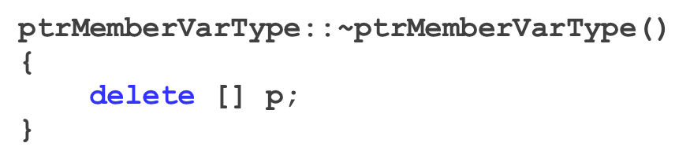
Destructor
If objectOne goes out of scope, its member variables are destroyed
Memory space of a dynamic array stays marked as allocated, even though it cannot be accessed
Solution: in destructor, ensure that when objectOne goes out of scope, its array memory is deallocated:

Slide 29

Assignment Operator
After a shallow copy: if objectTwo.p deallocates memory space to which it points, objectOne.p becomes invalid
FIGURE 12-15 Objects objectOne and objectTwo
Solution: extend definition of the assignment operator to avoid shallow copying of data

Slide 30
Copy Constructor (1 of 3)
Default member-wise initialization:
Initializing a class object by using the value of an existing object of the same type
Example:
ptrMemberVarType objectThree(objectOne);
Copy constructor: provided by the compiler
Performs this initialization
Leads to a shallow copying of the data if class has pointer member variables

Slide 31
Copy Constructor (2 of 3)
Similar problem occurs when passing objects by value
Copy constructor automatically executes in three situations:
When an object is declared and initialized by using the value of another object
When an object is passed by value as a parameter
When the return value of a function is an object

Slide 32
Copy Constructor (3 of 3)
Solution: override the copy constructor
For classes with pointer member variables, three things are normally done:
Include the destructor in the class
Overload the assignment operator for the class
Include the copy constructor

Slide 33
Inheritance, Pointers, and Virtual Functions (1 of 3)
Can pass an object of a derived class to a formal parameter of the base class type
Compile-time binding: the necessary code to call specific function is generated by compiler
Also known as static binding or early binding
Virtual function: binding occurs at program execution time, not at compile time
Declared with reserved word virtual

Slide 34
Inheritance, Pointers, and Virtual Functions (2 of 3)
Run-time binding:
Compiler does not generate code to call a specific function: it generates information to enable run-time system to generate specific code for the function call
Also known as late binding or dynamic binding
Note: cannot pass an object of base class type to a formal parameter of the derived class type

Slide 35
Inheritance, Pointers, and Virtual Functions (3 of 3)
Values of a derived class object can be copied into a base class object
Slicing problem: if derived class has more data members than base class, some data could be lost
Solution: use pointers for both base and derived class objects

Slide 36
Classes and Virtual Destructors (1 of 2)
Classes with pointer member variables should have the destructor
Destructor should deallocate storage for dynamic objects
If a derived class object is passed to a formal parameter of the base class type, destructor of the base class executes
Regardless of whether object is passed by reference or by value
Solution: use a virtual destructor (base class)

Slide 37
Classes and Virtual Destructors (2 of 2)
Virtual destructor of a base class automatically makes the destructor of a derived class virtual
After executing the destructor of the derived class, the destructor of the base class executes
If a base class contains virtual functions, make the destructor of the base class virtual

Slide 38
Abstract Classes and Pure Virtual Functions (1 of 2)
New classes can be derived through inheritance without designing them from scratch
Derived classes:
Inherit existing members of base class
Can add their own members
Can redefine or override public and protected member functions
Base class can contain functions that you would want each derived class to implement
However, base class may contain functions that may not have meaningful definitions in the base class

Slide 39
Abstract Classes and Pure Virtual Functions (2 of 2)
Pure virtual functions do not have definitions (bodies have no code)
Example:
virtual void draw() = 0;
An abstract class is a class with one or more virtual functions
It can contain instance variables, constructors, and functions that are not pure virtual
It must provide the definitions of the constructor and functions that are not pure virtual

Slide 40
Array-Based Lists (1 of 3)
List is a collection of elements of the same type
Common set of list operations
1. Create the list. The list is initialized to an empty state.
2. Determine whether the list is empty.
3. Determine whether the list is full.
4. Find the size of the list.
5. Destroy, or clear, the list.
6. Determine whether an item is the same as a given list element.
7. Insert an item in the list at the specified location.
8. Remove an item from the list at the specified location.
9. Replace an item at the specified location with another item.
10. Retrieve an item from the list at the specified location.
11. Search the list for a given item.

Slide 41
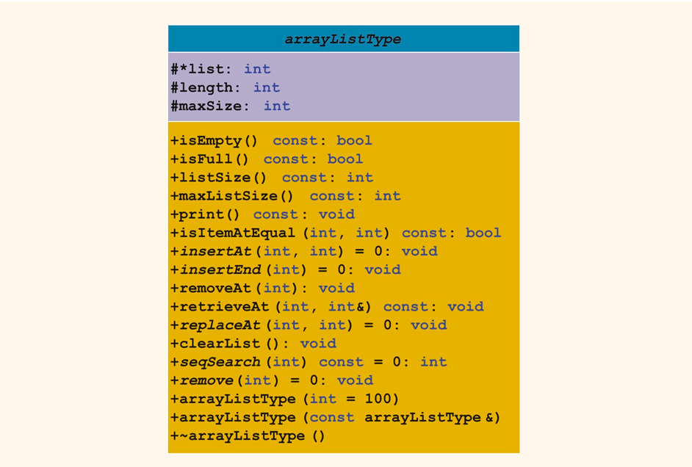
Array-Based Lists (2 of 3)
FIGURE 12-22 UML diagram for the class arrayListType

Slide 42

Array-Based Lists (3 of 3)
Lists can be unordered or ordered
Either type can be derived from abstract class arrayListType
Ordered list includes function insert to insert an item in its proper place
FIGURE 12-23 Array list

Slide 43
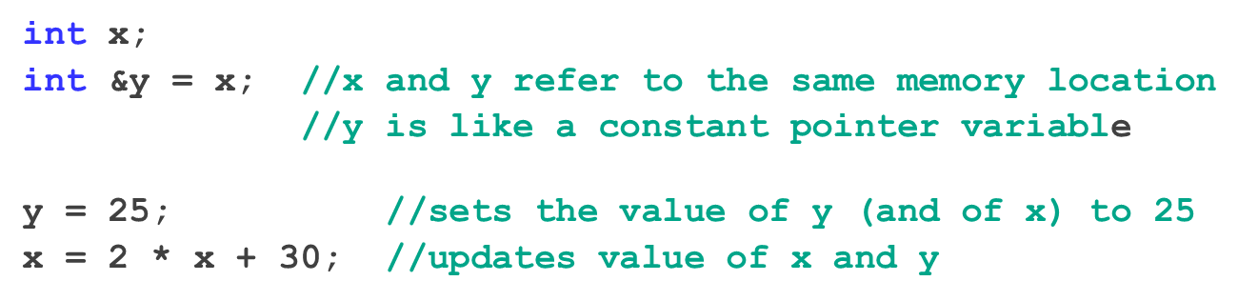
Address of Operator and Classes (1 of 2)
& operator can create aliases to an object
Example:

Slide 44
Address of Operator and Classes (2 of 2)
Address of operator can also be used to return the address of a private member variable of a class
However, if you are not careful, this operation can result in serious errors in the program

Slide 45
Quick Review (1 of 2)
Pointer variables contain the addresses of other variables as their values
Declare a pointer variable with an asterisk, *, between the data type and the variable
Address of operator (&) returns the address of its operand
Unary operator * is the dereferencing operator
Member access operator (−>) accesses the object component pointed to by a pointer

Slide 46
Quick Review (2 of 2)
Dynamic variable: created during execution
Created using new
Deallocated using delete
Shallow copy: two or more pointers of the same type point to the same memory
Deep copy: two or more pointers of the same type have their own copies of the data
Binding of virtual functions occurs at execution time (dynamic or run-time binding)
A list is a collection of elements of the same type. Can be ordered or unordered
Common set of list operations

